Slide 1


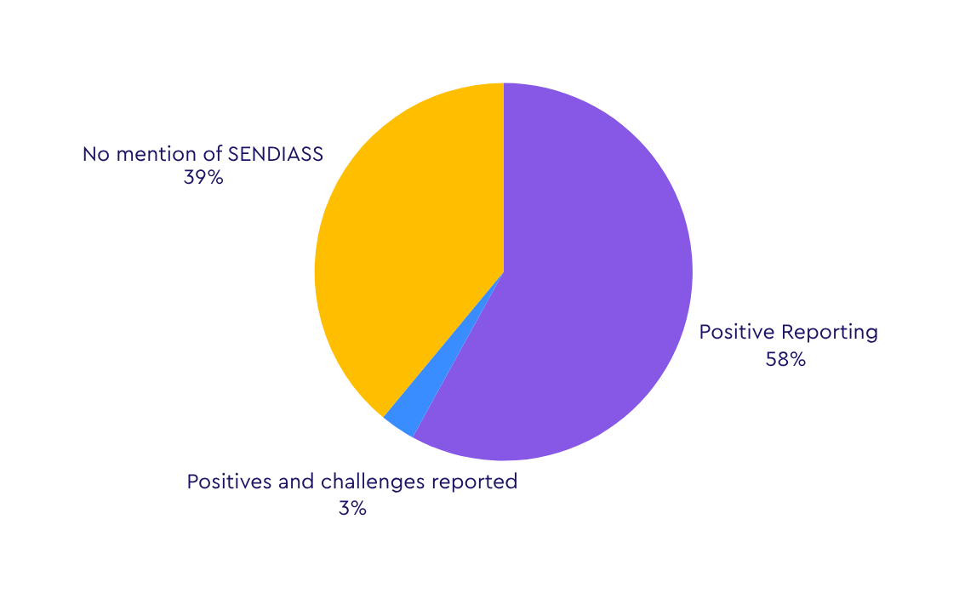

Assessing the national picture of SENDIAS services considering the key measure of Ofsted reporting
Ofsted Scores
Of SENDIAS service mentions in 34 Ofsted reports, we have divided the comments into four categories for reference: where the comments were positive; where the comments contained both positives and challenges; where the comments were not positive; and where there was no mention at all.
20
13
1
No report described SENDIAS services only negatively.

Slide 2
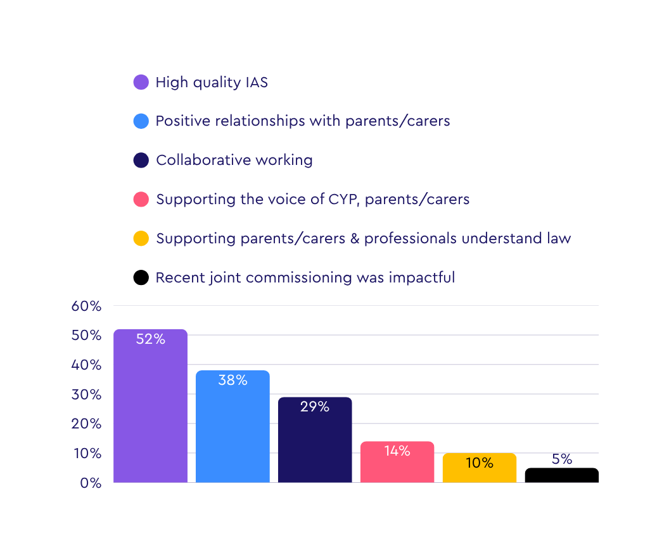
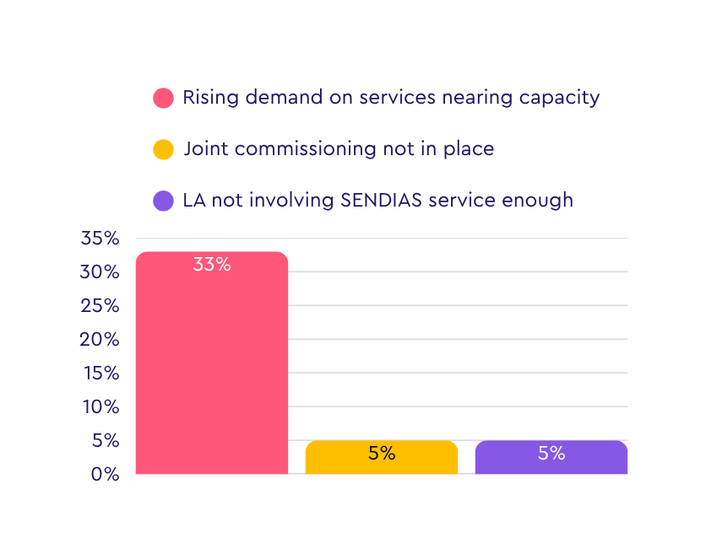



Themes Present in Ofsted Reporting of SENDIAS Services
Positive Themes
Challenges
192%
25%
70%
37%
Biggest increase: Casework (351% over 5 years).
Funding struggles to keep pace: funding growth (70%) vs. Inflation (25.2%) and casework (351%)
Minimal staffing growth: An increase of 37% in 5 years

Slide 3





KEY TAKEAWAYS
There has been an increase in Ofsted/CQC reports mentioning SENDIAS services compared to last year (61% in the 2024-25 report vs 56% in the 2023-24 report).
1/3rd of Ofsted/CQC reports that mentioned SENDIAS services highlighted capacity as the major issue confronting services.
The quality of support given by SENDIAS services is a major positive that was highlighted in Ofsted reports.
If you have any questions, please contact the Information Advice and Support Services Network : iassn@ncb.org.uk
IASSN Website

