Slide 1




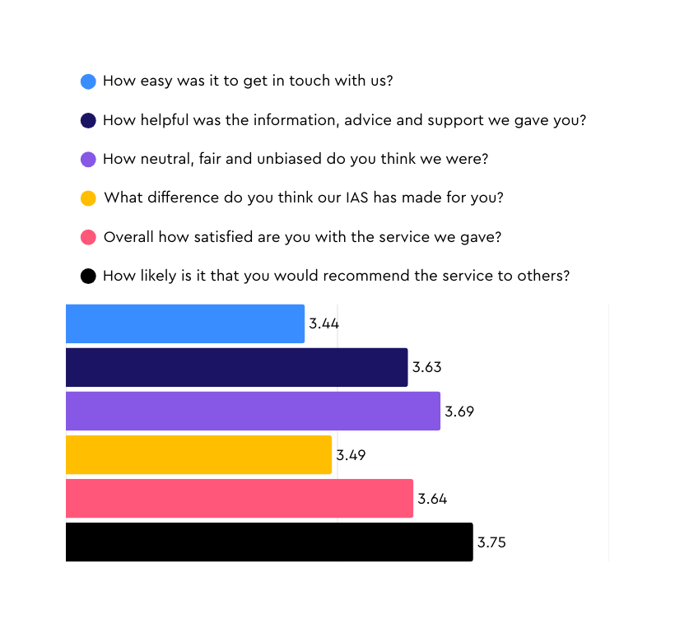




Snapshot of Service User Feedback Report 2024-2025
Based on 30+ sequential pieces of service user feedback provided by services covering 153 Local Authority Areas
Overview
 | 2023-2024 | 2024-2025
Number of services providing feedback | 127 | 112
Total pieces of feedback: | 9230 | 6422
Average per service | 73 | 97
From parents | 5633 | 5293
From children (0–16): | 26 | 22
From young people | 131 | 76
Unspecified | 3440 | 1031
All services ensure they ask six specific questions to service users as part of their feedback processes. Those 6 questions are rated 0-4 with 0 being low and 4 being the maximum. Those six questions and their mean (average) score from sequential pieces of feedback from service users this year are below.
2024-2025 Mean Scores
(Maximum possible: 4.00)
Total Mean Score for 2024–2025: 3.61 out of 4.00

Slide 2
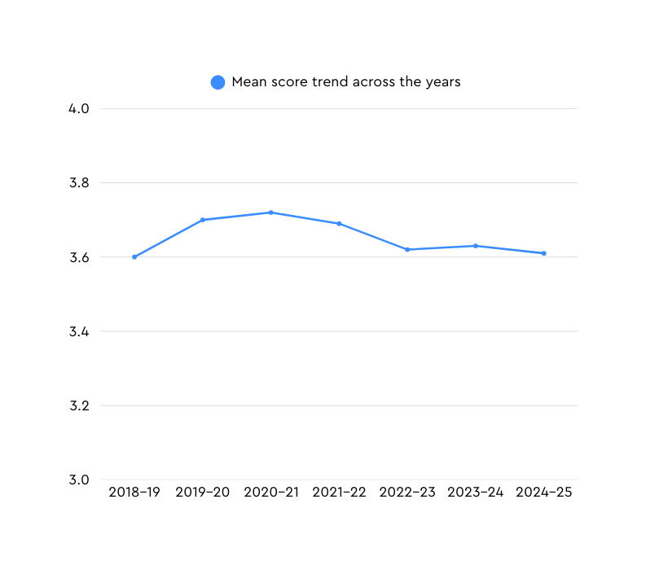
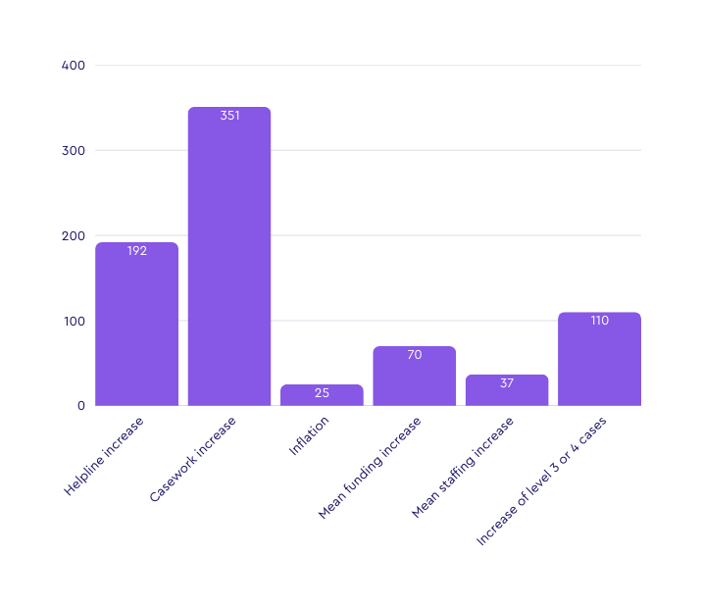



3.70
3.72
3.69
3.62
3.60
3.63
3.61
Services continue to receive very high scores across the board. The slight downward trend since 2020 must be understood alongside the rising pressures on SENDIAS services as seen below.
Comparing funding increase with % growth of casework, inflation, and staffing (2019-2024)
SENDIASs have therefore potentially saved LA’s over 61 million in Tribunal costs alone
The combined cost of every SENDIASs is around 24 million per annum
Biggest increase: Casework (351% over 5 years).
Funding struggles to keep pace: funding growth (70%) vs. Inflation (25.2%) and casework (351%)
Minimal staffing growth: An increase of 37% in 5 years
Growing pressures on SENDIAS services are not being matched with funding. Yet, service user scores are very high, reflecting the continuing impressive work of SENDIAS services.
If you have any questions, please contact the Information Advice and Support Services Network
iassn@ncb.org.uk
IASSN Website

