Slide 1




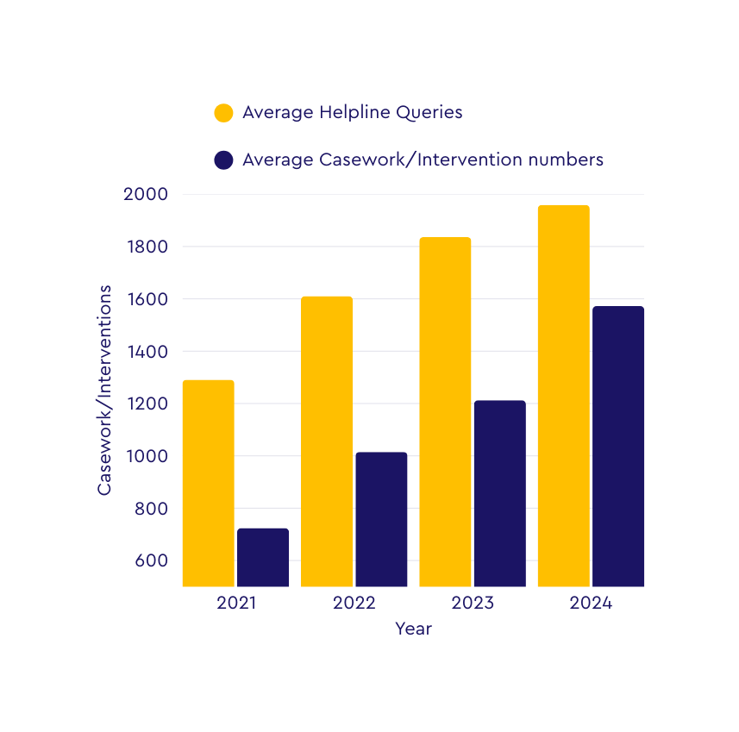
SEND Tribunal Overview
Snapshot of data regarding SENDIAS services and the SEND Tribunal
Supporting children, young people and families ‘when things go wrong’ including before, during and after a SEND Tribunal, is a statutory part of the role of SENDIAS services as detailed in chapter 2.19 of the SEND Code of Practice.
Casework/Interventions and tribunals per service since 2021
1836
1959
1610
1572
1291
1212
1015
724
 | % Increase 2023-24 | % Increase since collecting data (2019)
Average helpline enquiries | 7% | 192%
Average casework/ intervention numbers | 29% | 351%

Slide 2


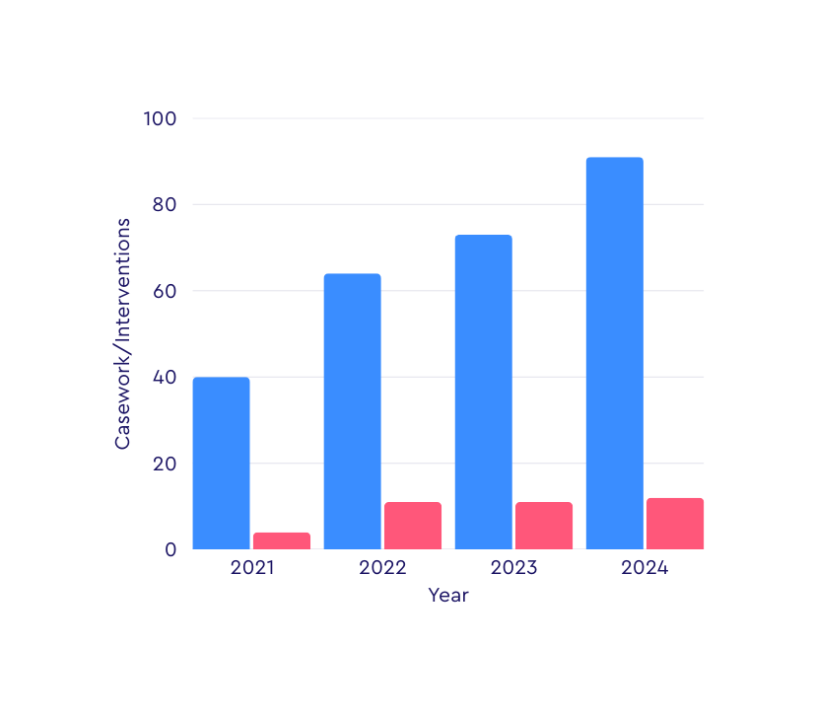



Average number of Tribunals that Services gave information/ advice/ support on (Intervention Levels 1 to 3.
Click here for Intervention Guidance
Average number of Tribunals that services directly supported/ represented parents and/ or children and young people at (Intervention Level 4).
91
73
64
40
Biggest increase: Casework (351% over 5 years).
Minimal staffing growth: An increase of 37% in 5 years
4
11
11
12
 | % Increase 2023-24 | % Increase since collecting data (2019)
Average number of Tribunals that services gave information/ advice/ support regarding (Levels 1 to 3) | 24% | 128%
Average number of Tribunals that services directly supported/ represented parents and/ or children and young people at (Level 4) | 9% | 200%

Slide 3






Total number of SEND Tribunals in 2024:
21,106
% of Tribunals services gave Level 1 to 3 support to
% of Tribunals services gave Level 4 support to
65 %
9%
13741 out of 21106 Tribunals
1812 out of 21106 Tribunals
48
Average number of Tribunals SENDIAS services self-report they help avoid
£8500
How much The Guardian report estimated as a single Tribunal cost
SENDIAS services have therefore potentially saved LAs over £61 million in Tribunal costs alone
The combined cost of every SENDIAS service is around £24 million per annum
The total cost of all SENDIAS service budgets combined in 2024–25 was £24,226,806. SENDIAS services save local authorities approximately 2.5 times the amount these services cost.

Slide 4


Tribunal Avoidance - Key themes
We asked SENDIAS services to give more detail on how their work supporting early resolution helped avoid Tribunals. We took the replies from the 125 services who completed that question and identified themes.
Theme | No. of services that included theme in their response | % of 125 services
Informal mediation and communication support | 64 | 51.2%
Formal mediation support | 48 | 38.4%
General guidance and support on SEN systems | 34 | 27.2%
Evidence gathering and case preparation | 19 | 15.2%
Legal guidance | 8 | 6.4%
Consent Order support | 4 | 3.2%
Unspecified mediation support | 3 | 2.4%
Unspecified/ categorical data | 3 | 2.4%
If you have any questions, please contact the Information Advice and Support Services Network
iassn@ncb.org.uk
IASSN Website

